Slide 1

Inverse Trig Functions
CSM PRESS 2025

Slide 2
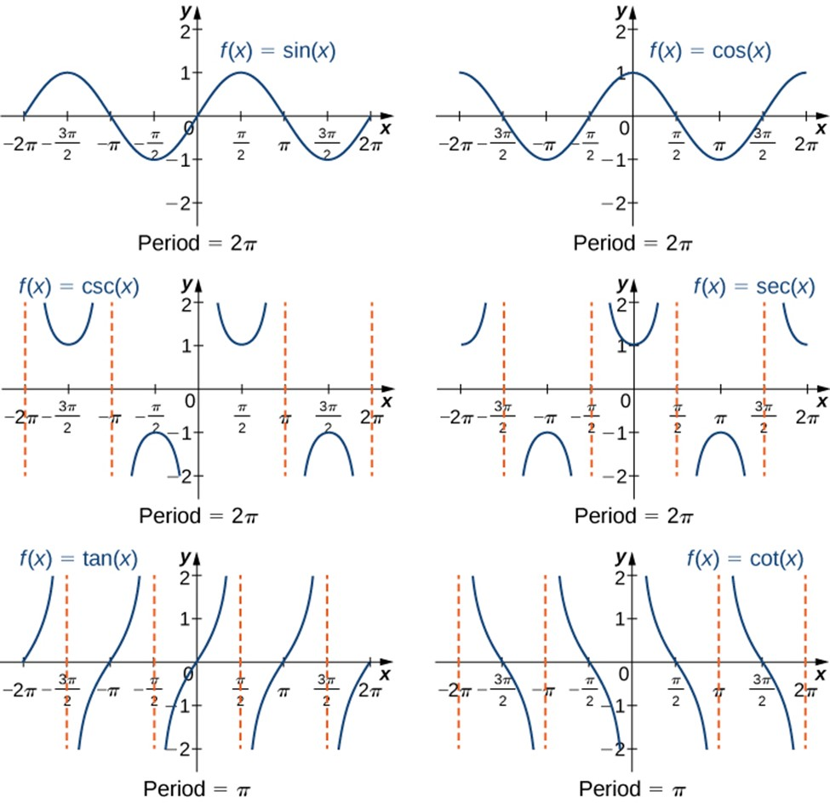
Inverse Trig Functions
THE PROBLEM
Recall that only one-to-one functions have an inverse.
In general, since trigonometric functions are not one-to-one, they don’t have inverse functions.
THE SOLUTION
This problem is overcome by restricting the domains of these functions so that they become one-to-one.

Slide 3
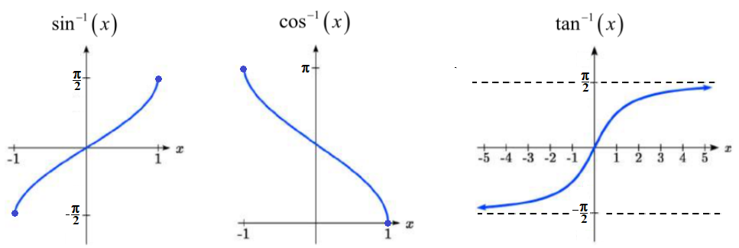
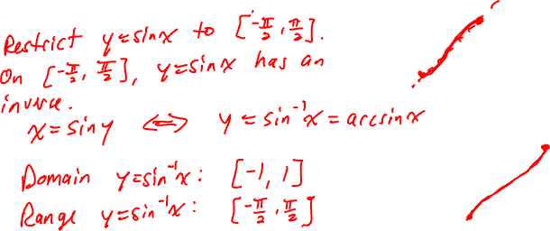
The Inverse Sine Function

Slide 4
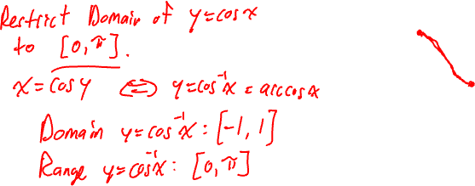
The Inverse Cosine Function

Slide 5
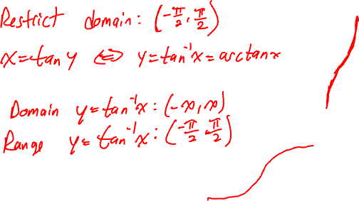
The Inverse Tangent Function

Slide 6
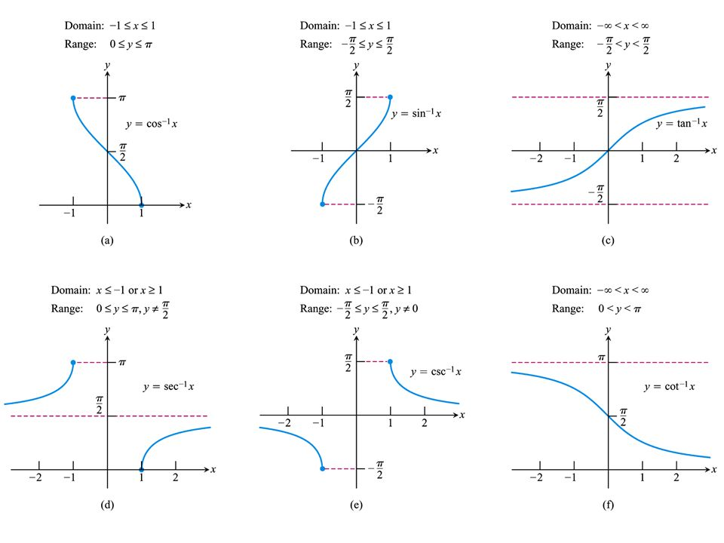
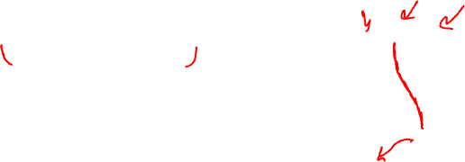
Inverse secant, cosecant, cotangent

Slide 7


Inverse Trig Functions
Note that trigonometric functions input angles and output numbers (or ratios).
It makes sense that inverse trigonometric functions do the reverse. That is, inverse trig functions input numbers (or ratios) and output angles!
Note that the “$−1$” looks like it’s in the exponent position, but it’s not. This is simply notation that we use to denote inverse trig functions. That is:

Slide 8

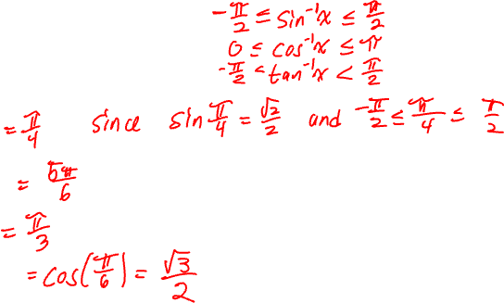
Examples
Evaluate each of the following.
$$\sin^{−1}\left(\frac{\sqrt{2}}{2}\right)$$
$$\cos^{−1}\left(−\frac{\sqrt{3}}{2}\right)$$
$$\tan^{−1}\left(\sqrt{3}\right)$$
$$\cos\left(\sin^{−1}\left(\frac{1}{2}\right)\right)$$

